Slide 1
Easy Farming
Final year project
Defence Presentation

Slide 2
Our Team
Sohaib Afzal
Ch Mushabber
Laiba Ashfaq
Frmer

Slide 3
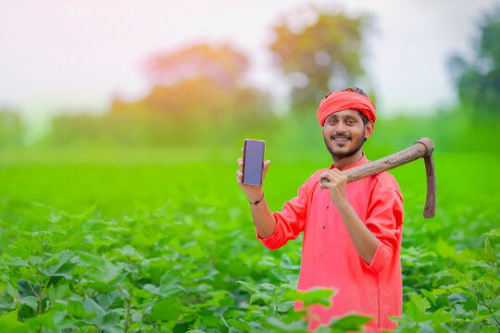
The EasyFarming App is a revolutionary digital platform designed to empower farmers in Pakistan by addressing some of the most pressing challenges in the agricultural sector. Agriculture is the backbone of Pakistan's economy, yet many farmers struggle due to decreasing crop prices, high costs for seeds and fertilizers, and exploitation by middlemen who purchase their produce at unfairly low prices.
Introduction
+2,2M
+2,5M
Easy Farming
Easy Farming
Common Wheat
Durum Wheat
Emmer Wheat
Asian rice
African rice

Slide 4
Table of Content
Brief Description
Challanges
Proposed methadology
Tools to be used
Expected Result
Conclusion

Slide 5
Brief Description:
Agriculture is important for every country's economy, and for Pakistan, an agricultural nation, it plays a significant role in economic growth. However, Pakistani farmers face serious problems. The government recently lowered crop prices, while the costs for seeds, fertilizers, and other supplies remain high. Middlemen also exploit farmers by buying produce at low prices and keeping large profits for themselves. This situation makes it hard for farmers to earn a decent living and support their families.
To solve these issues, the EasyFarming App should be introduced to farmers in Pakistan. This app will connect farmers directly with buyers, removing the need for middlemen. It ensures farmers get fair prices for their crops and provides support for transporting produce. By using technology, the EasyFarming App aims to help farmers earn more and improve their lives.

Slide 6
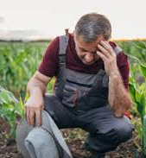
Basic Problem
Soil degradation and fertility
Soil erosion, nutrient depletion, and salinization can reduce soil fertility and affect crop growth.
Market fluctuations and price volatility
Unstable market prices, lack of market access, and limited bargaining power can affect farmer’s income.
What’s Problem
farmers face significant challenges that hinder their ability to thrive. Recently, the government lowered crop prices, exacerbating the financial strain on farmers who already struggle with high costs for essential supplies like seeds and fertilizers
What’s Problem
The exploitation by middlemen adds another layer of hardship. These intermediaries purchase produce from farmers at substantially low prices, reaping large profits while the farmers themselves receive minimal compensation for their hard work

Slide 7
Challenges
01
Middlemen Resistance
02
Logistical Support
03
04
Low cost of crops
Scalability

Slide 8
Proposed Methodology:
The EasyFarming App is designed to directly connect farmers with buyers, eliminate middlemen to ensure fair pricing. It will provide a user-friendly digital marketplace, detailed listings, and logistical support for transportation. This platform aims to enhance transparency, increase farmers' earnings, and expand their market reach, thereby transforming the agricultural sector in Pakistan.
This app tell us about the all the fertilizer are best for your crops, they tell us about the type of fertilizer (production of crops).

Slide 9






Tools to be used
01
Git Hub (version Control)
02
Kotlin (Frontend)
03
NODE.js+Express (Backend)
04
MangoDB (Database)

Slide 10
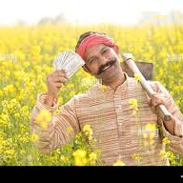
Expected Results:
The EasyFarming App is expected to deliver several key Outcomes:
Increased Farmers' Income: Eliminate middlemen to provide fair prices for produce, improving financial stability.
Enhanced Market Access: Expand market reach to urban centers and international buyers.
Improved Transparency: Promote transparent pricing and quality standards.
Streamlined Logistics: Reduce delays and transportation issues to ensure fresher produce reaches the market.
Farming literacy: new techniques related to the farming.

Slide 11
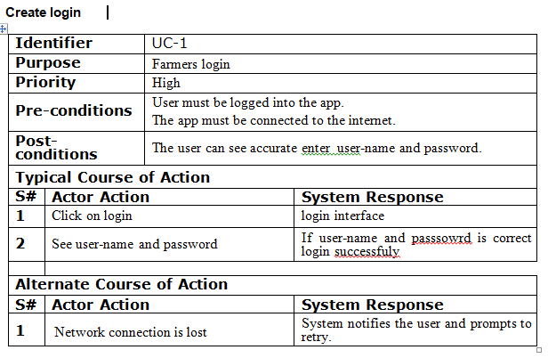
USE CASES

Slide 12
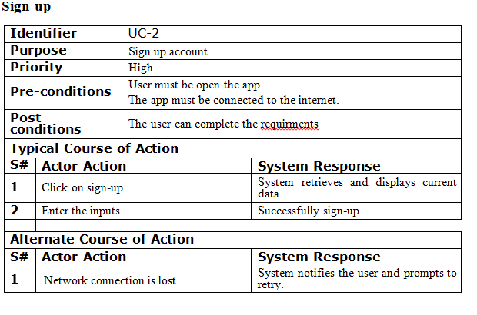

Slide 13
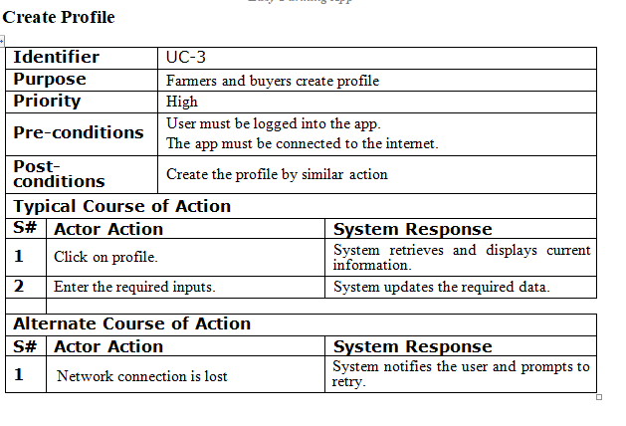

Slide 14
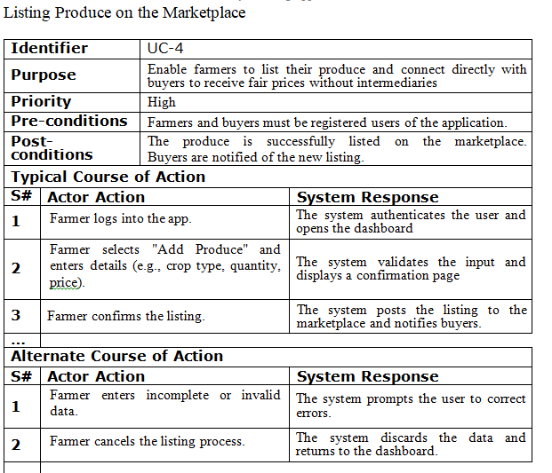

Slide 15
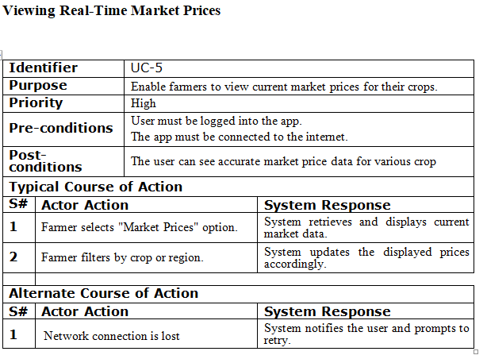

Slide 16
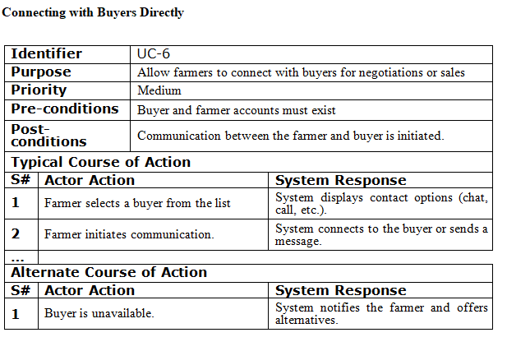

Slide 17
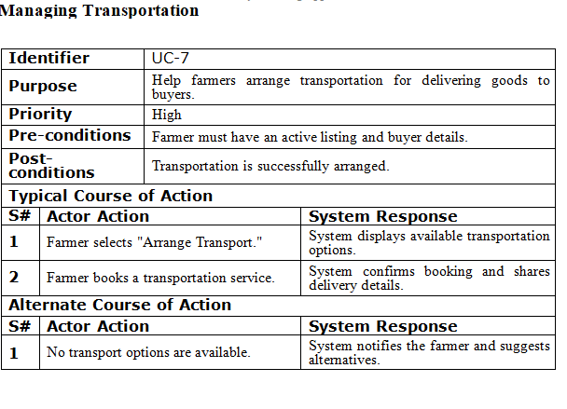

Slide 18
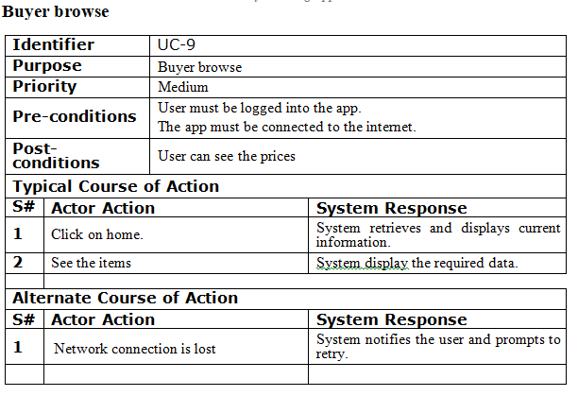

Slide 20
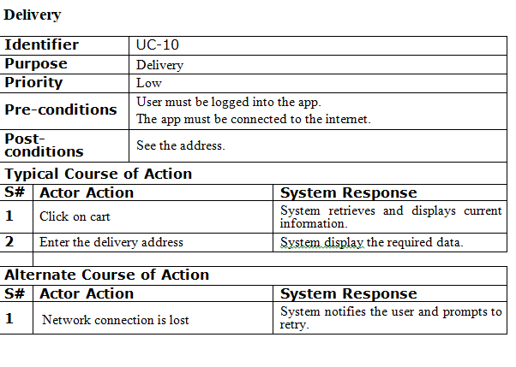

Slide 21
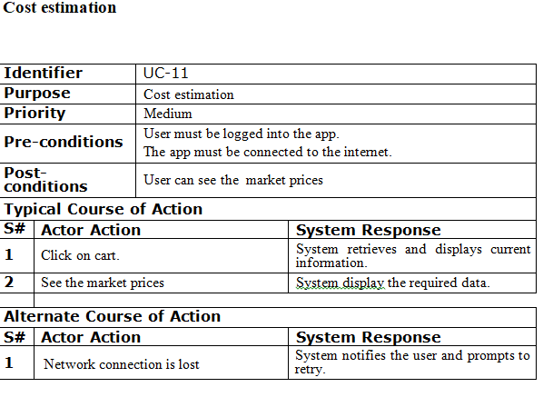

Slide 22
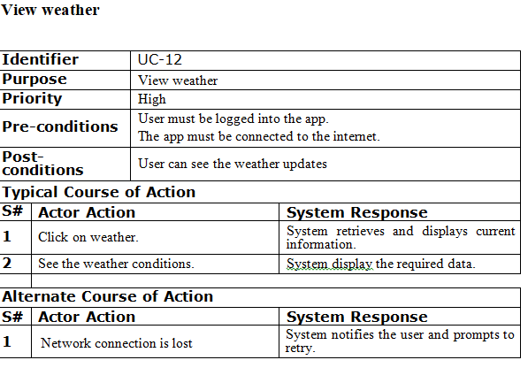

Slide 23
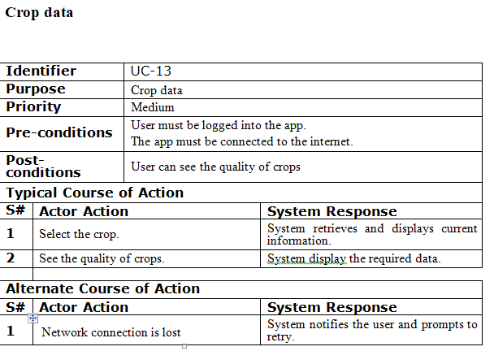

Slide 24
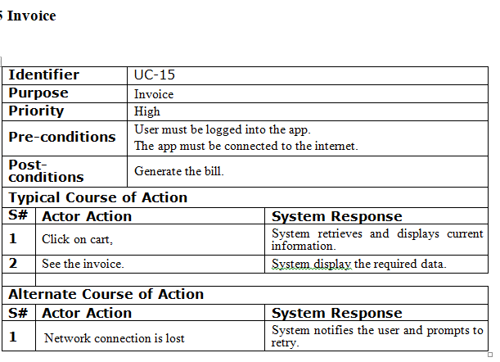

Slide 25
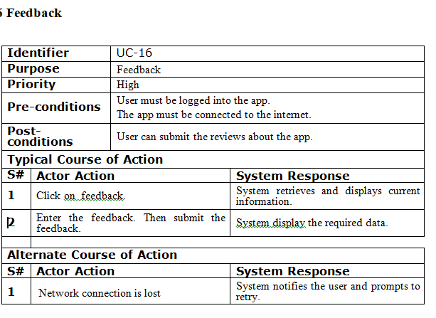

Slide 26
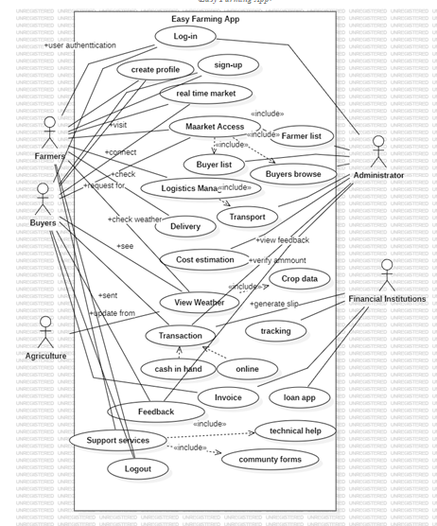
PHASE 1 Diagrams
USE CASE

Slide 27
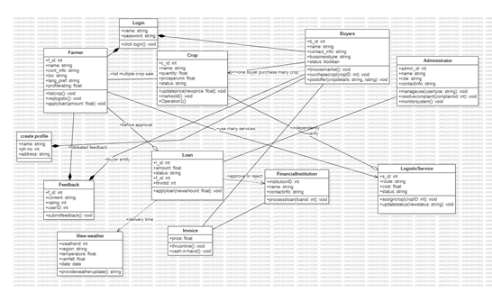
CLASS DIAGRAM

Slide 28
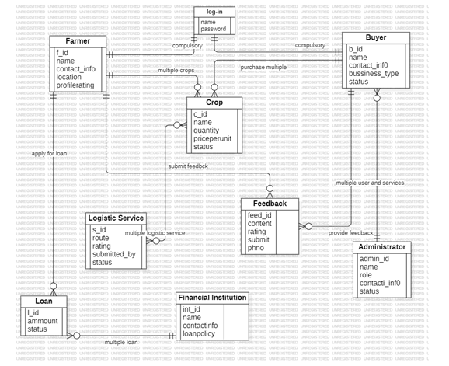
ER DIAGRAM

Slide 29
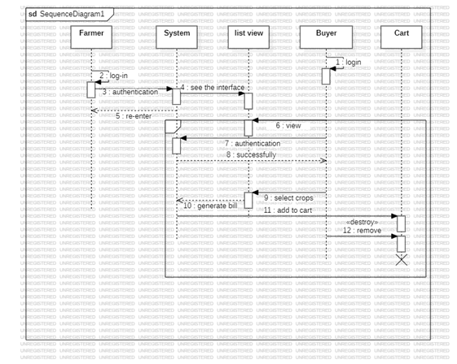
SEQUENCE DIAGRAM

Slide 30
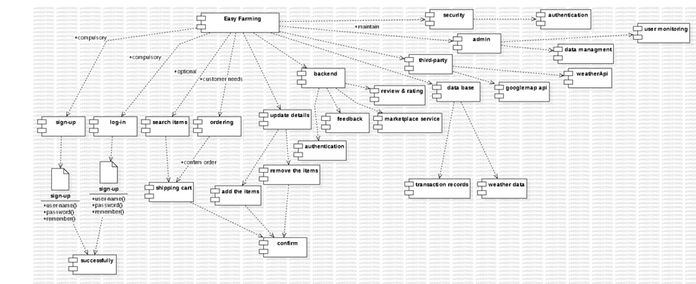
PHASE 2 DIAGRAMS
COMPONENT DIAGRAM

Slide 31
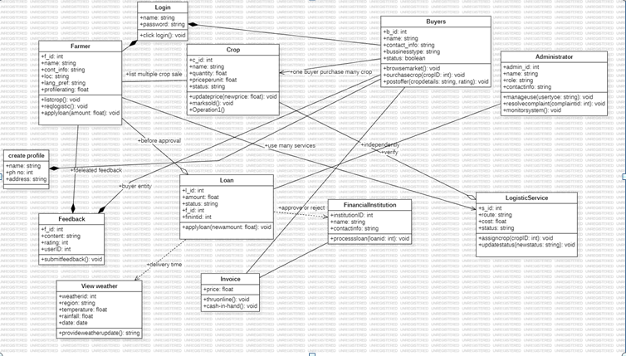
CLASS DIAGRAM

Slide 32
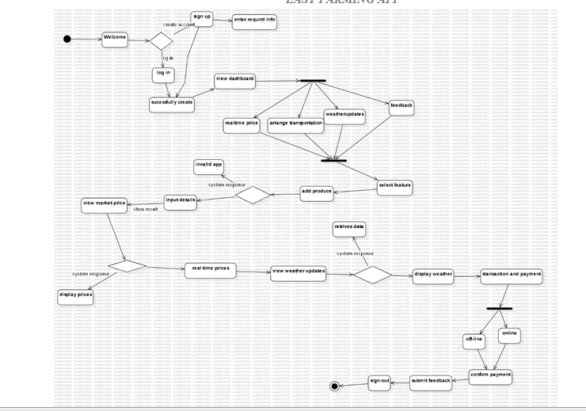
ACTIVITY DIAGRAM

Slide 33
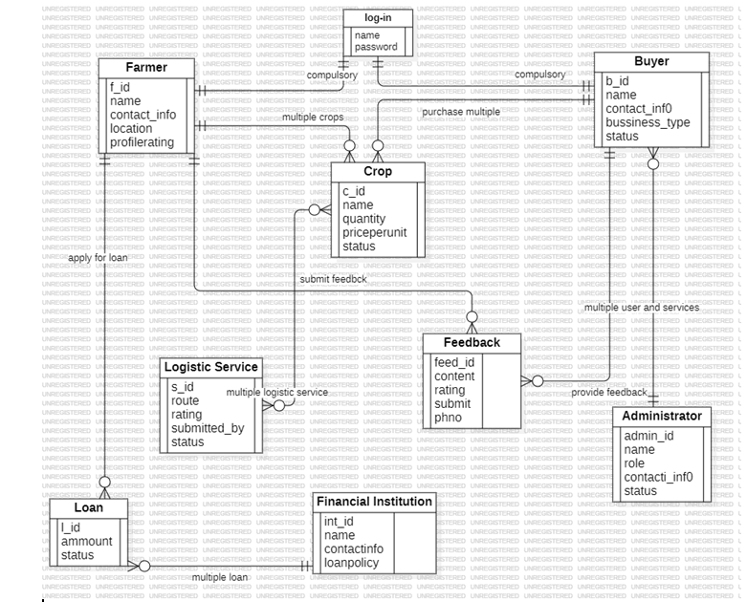
ER DIAGRAM

Slide 34
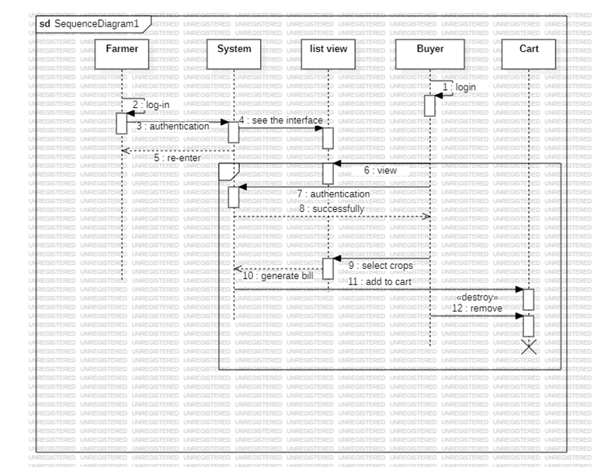
SEQUENCE DIAGRAM

Slide 35
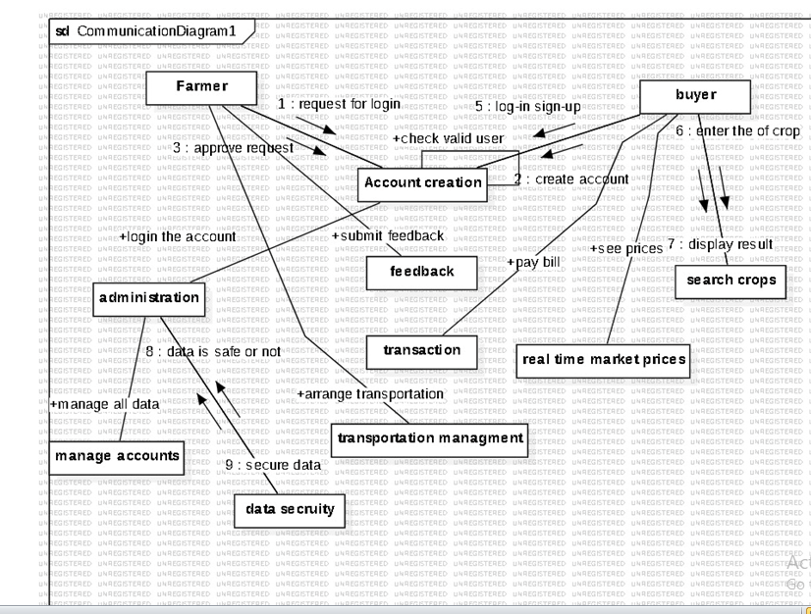
COLLABORATION DIAGRAM

Slide 36
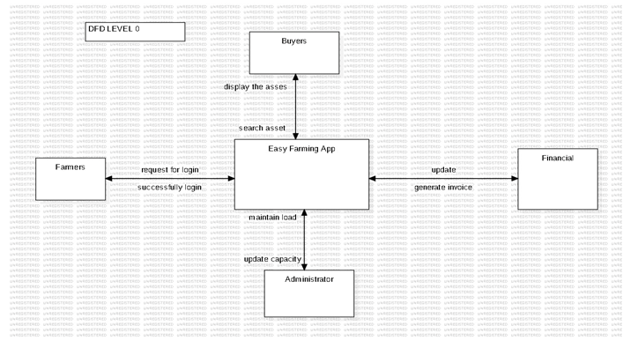
DFD LEVEL0

Slide 37
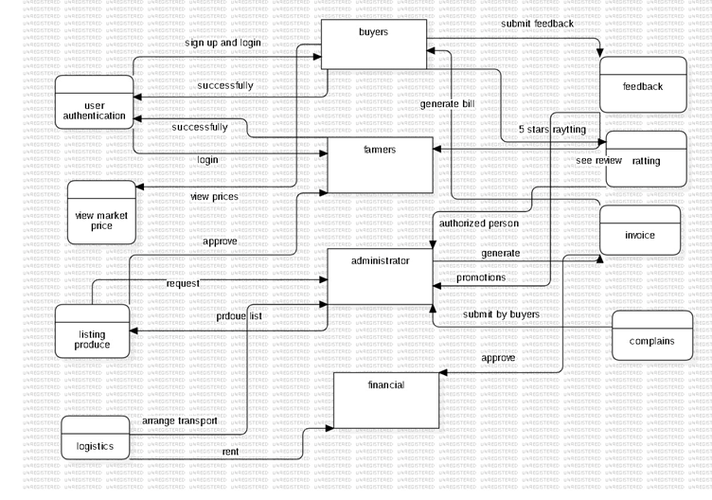
DFD LEVEL1

Slide 38
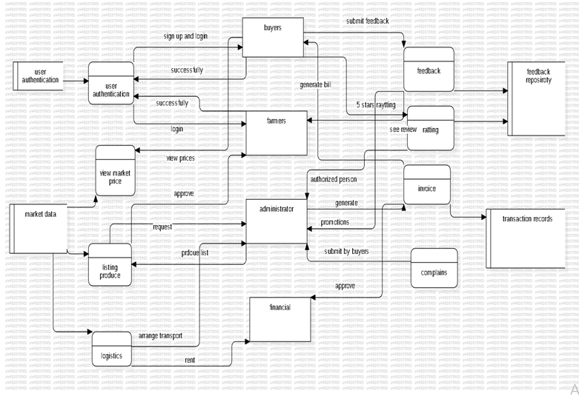
DFD LEVEL2

Slide 39
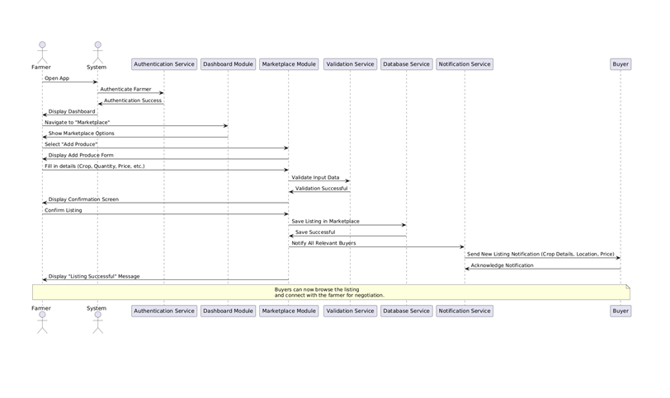
EVENT TRACES

Slide 40
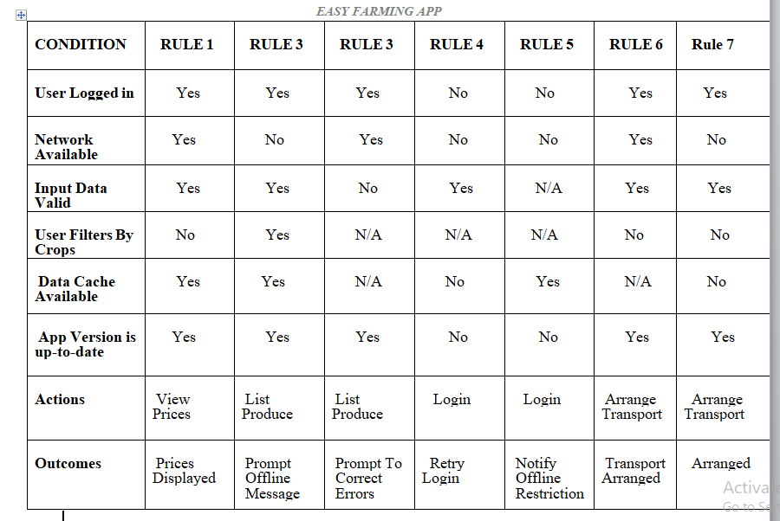
DECISION TABLE

Slide 41
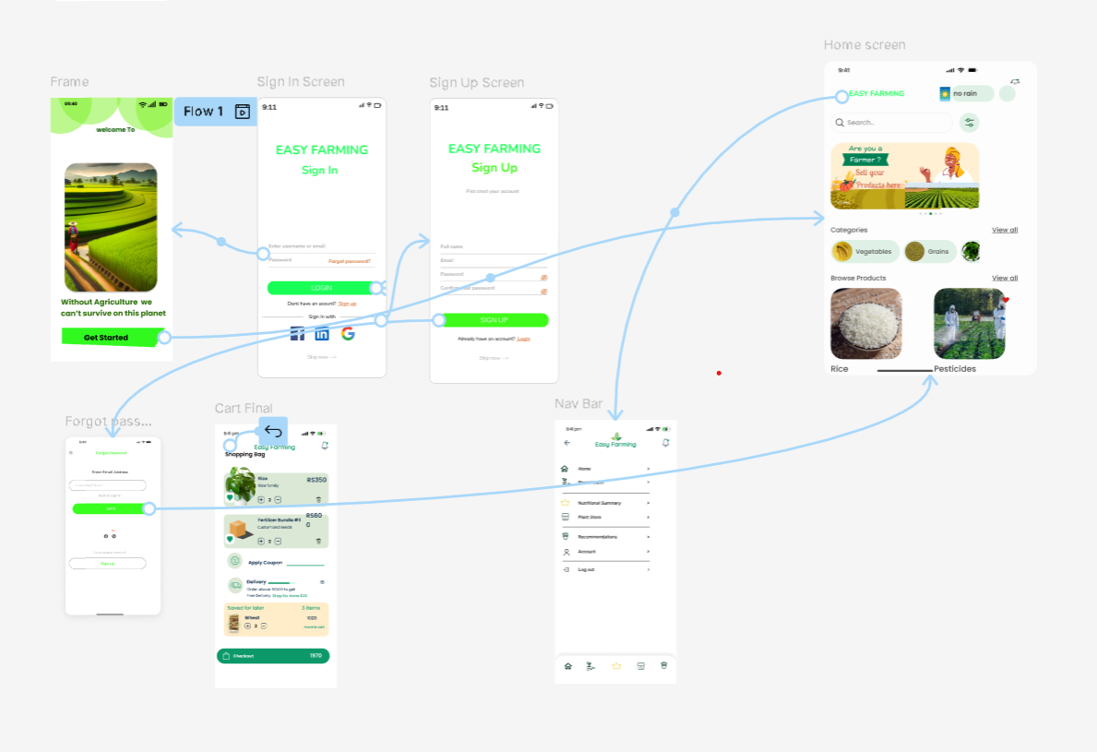
PROTOTYPE AND SCREENS

Slide 42
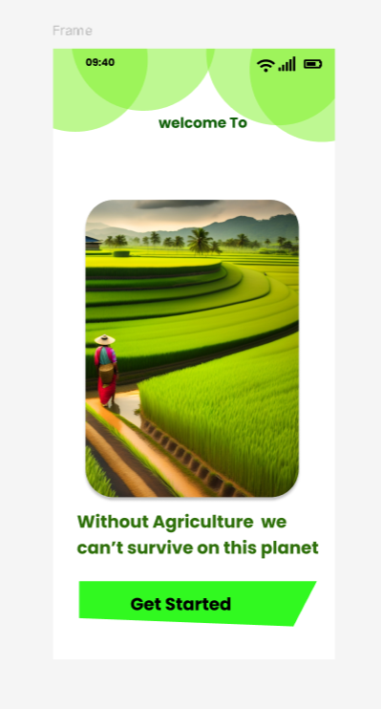
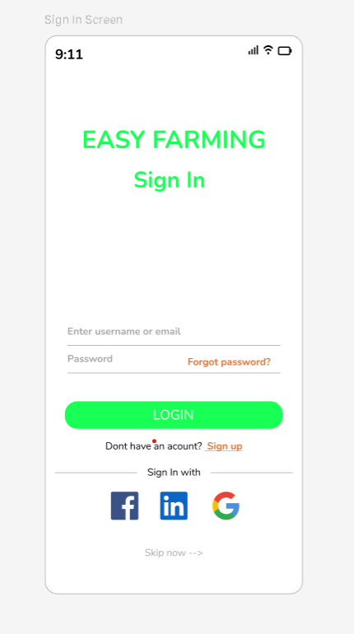
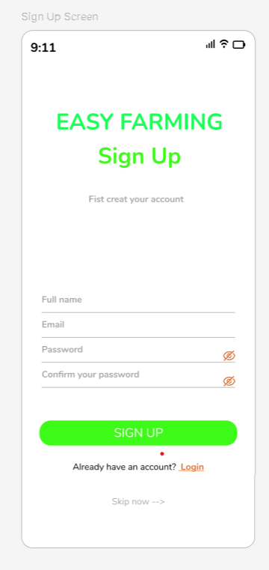
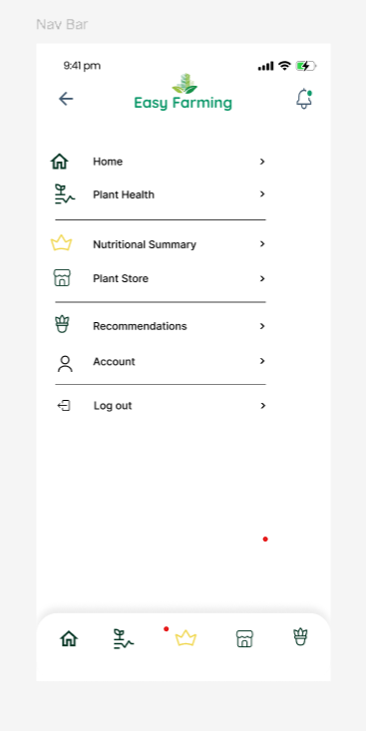

Slide 43
